Slide 1


WELCOME
THE AERO CLUB SAFETY CAMPAIGN 2017
SAFETY CAMPAIGN
Notes:
Greating: Good day, on behalf of the AWC team and I would like to present the following at the safety road show campaign

Slide 2

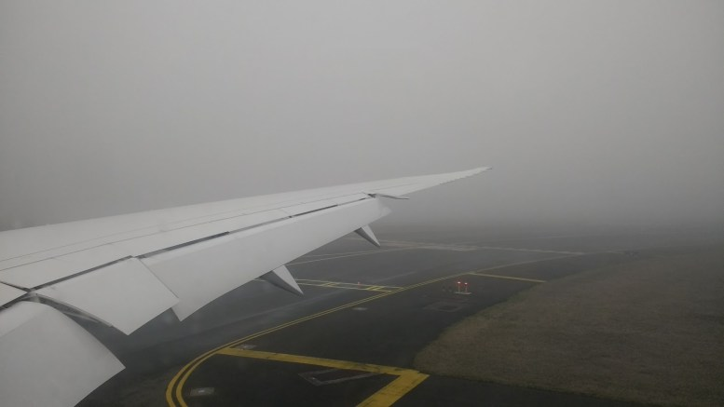
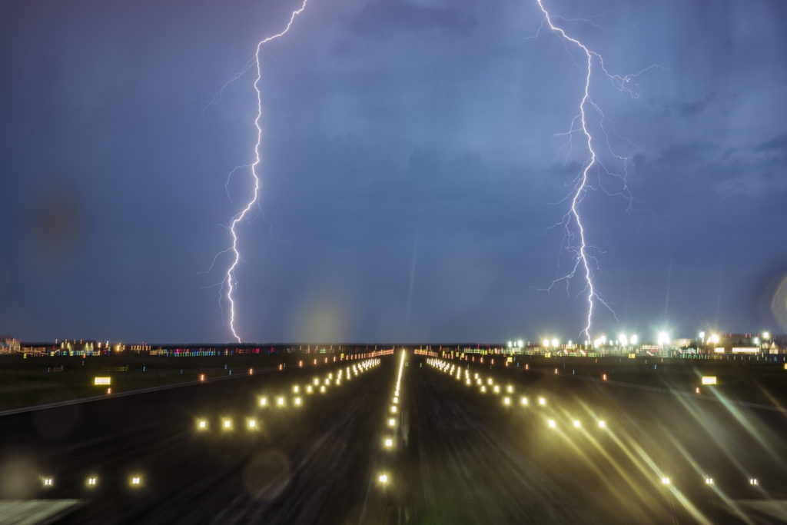
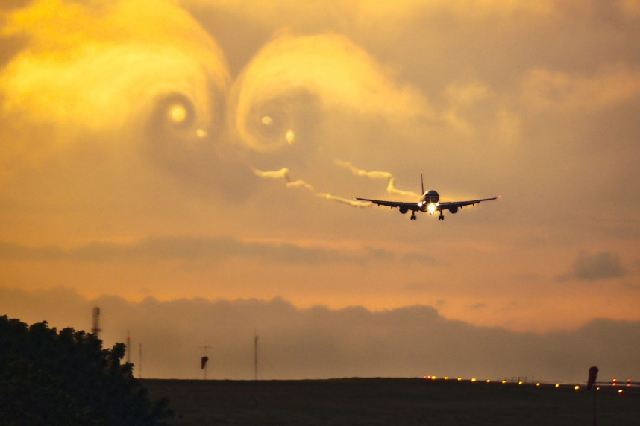
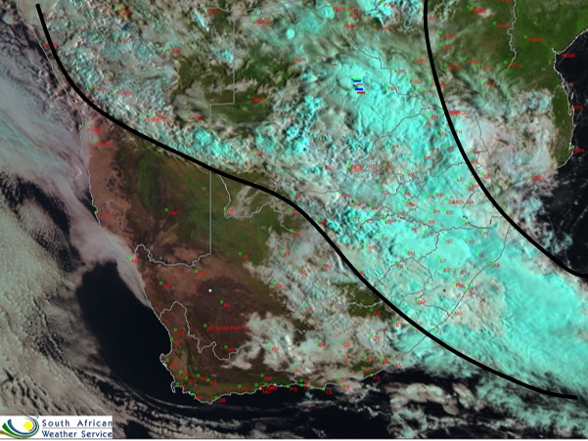
DO YOU KNOW WHEN TO FLY?
In fog??
Storm??
Turbulence??
ICING?
Notes:
The number one question we would like to emphazie on is: Do you know the weather and know if you will be able to fly?

Slide 3
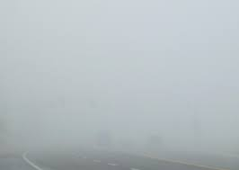
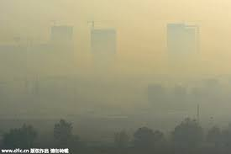

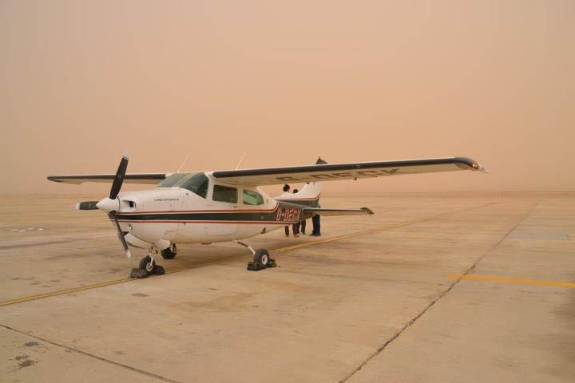
WEATHER HAZARDS (Low cloud and poor Vis)
HAZE
FOG/MIST
RAIN
DUST
Notes:
Hence knowing the various weather hazards are essential: Visual flights are normally the ones highly affected by these, but wind shear/turbulence and thunderstorms are still a huge risk for IFR flights. Also mention SMOKE and ASH clouds.

Slide 4
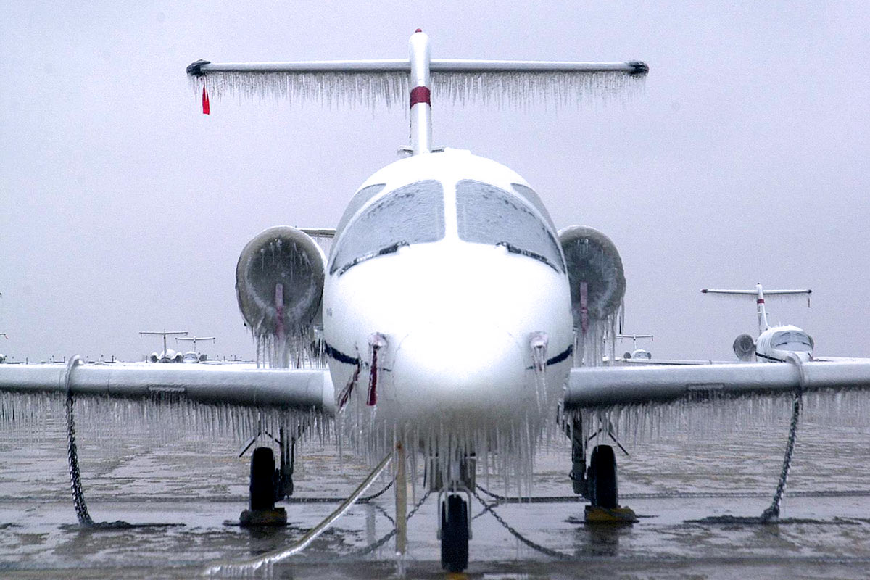
WEATHER HAZARDs (ICING)
Increased stall speed
Decreased drag
Increased weight
Decreased lift
Notes:
Here I would like to take you through the various weather hazard: You get inflight icing and ground icing. Inflight icing is the most dangerous because of the above mentioned.

Slide 5
WEATHER HAZARDS (Thunderstorms)
Most violent and threatening weather phenomena
Every hazard under one umbrella
Moderate-Severe Icing
Small-Large hail
Moderate-Severe turbulence
Light-Heavy precipitation
Low Vis
Lightning
tornado
Types of TS
Air-mass TS- common in summer
Orographic TS
Frontal TS- with the approach of cold-front
PS: Gust front- strong downburst that run ahead of a storm causing a change in wind. This may occur in clear skies and can be nasty for the unwary pilot.
Notes:
Thunderstorm affect both VFR and IFR.
Which leads to the following effects:
3 Types: Air-mass: Single isolated cell sort lived Triggered by lifting: Sea-breeze & Land-breeze Mountain-valley circulation Solar heating
Orographic: unstable moist air forced up by a mountain or hillside
Frontal: develop at the boundary or front of two different air masses
Also menschen TCU – icing & mod to heavy showers – decrease visibility
(This slide will probably take more time as it is detailed. Basically explains thunderstorms, its types and place emphasize on how both VFR and IFR are affected by them.)

Slide 6
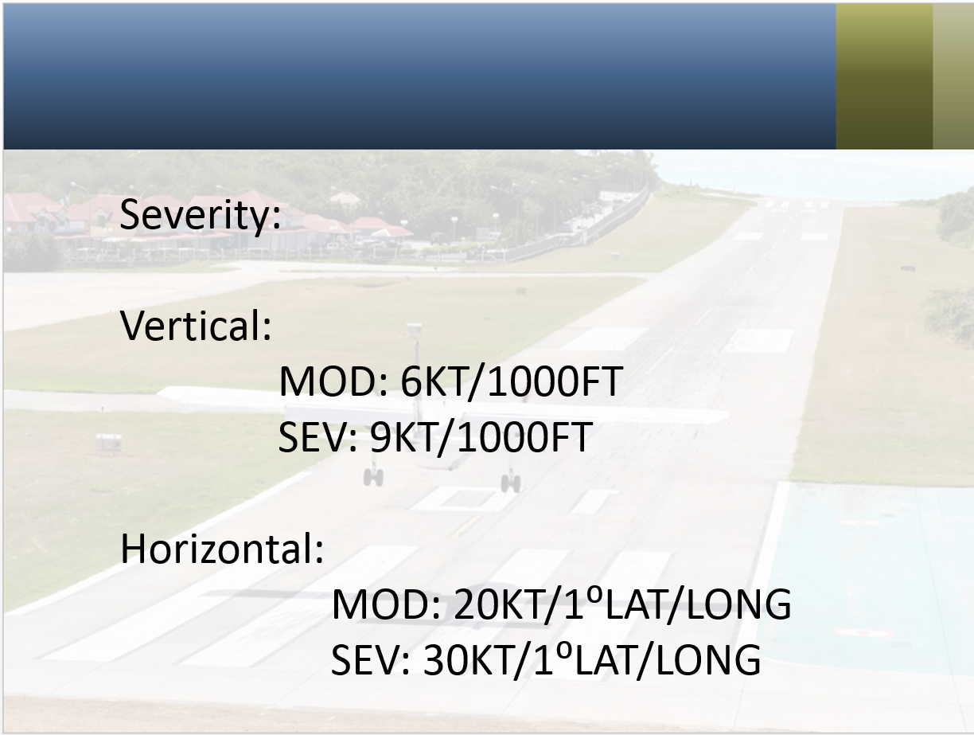
WEATHER AND HAZARDS (WIND SHEAR AND TURBULENCE)
What is turbulence?
Wind currents that vary greatly over short distances
What is wind shear
A change in horizontal wind speed and/or direction with height. Biggest danger in lowest 1500 feet AGL.
Types of turbulence/wind shear
Thermal turbulence- Occurs when surface is sufficiently warm, vertical currents of air form (mostly in summer and spring).
Thunderstorm turbulence
Mountain Waves- Winds of 15kt and above mountains, blowing perpendicular on the mountain top.
Low-Level wind shear- 15kt difference between the ground and 1500ft above.
Frontal turbulence
Notes:
(I think we should include the severity table for turbulence. Otherwise the slide is self explanatory)

Slide 7
ARE YOU VFR???
These standard conditions may vary by country
Visual Flight Rules – conditions under which pilot have sufficient visibility to fly the aircraft, but maintaining visual separation from terrain and other aircraft
VFR | IFR
Flying on sight | Use instruments
Clouds: 1500 ft and lower | Clouds: None
Visibility: 5000 meters or lower | Visibility: None
Thunderstorms | Thunderstorms
Strong winds – aircraft weight | Strong winds – aircraft weight
Notes:
Different flight rules: Differences are:
(This table should be read out )
Therefore VRF or IFR piolets need to know the weather conditions before take off and land and En Route

Slide 8
BASIC TERMINOLOGY
CAVOK
Visibility >10 km or more
No cloud of operational significance
EMBD TS
Thunderstorms over a large area
Not easily identifiable
ISOL TS
Thunderstorms significantly apart from each other
OVC CLOUD 8/8
BKN CLOUD 5-7 octas
SCT CLOUD 3-5 octas
Notes:
These are terms private pilots who call for briefings do not understand

Slide 9
PLANNING YOUR FLIGHT
Check Aviation website for useful products
(Spotgraph winds, Weather charts, TAFs, Warnings)
Make sure you understand all products
Call for a weather briefing
Check for updates in the weather
Notes:
When should a weather briefing occur?
(Explain to them that the weather briefing should only occur if they are not sure about the forecast, not because they have not looked at the products

Slide 10
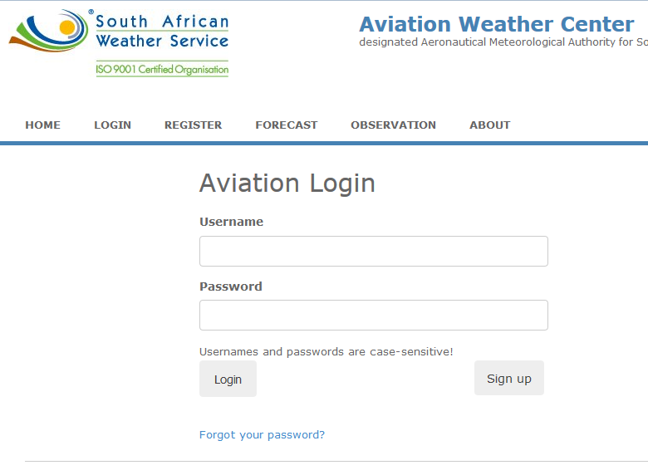
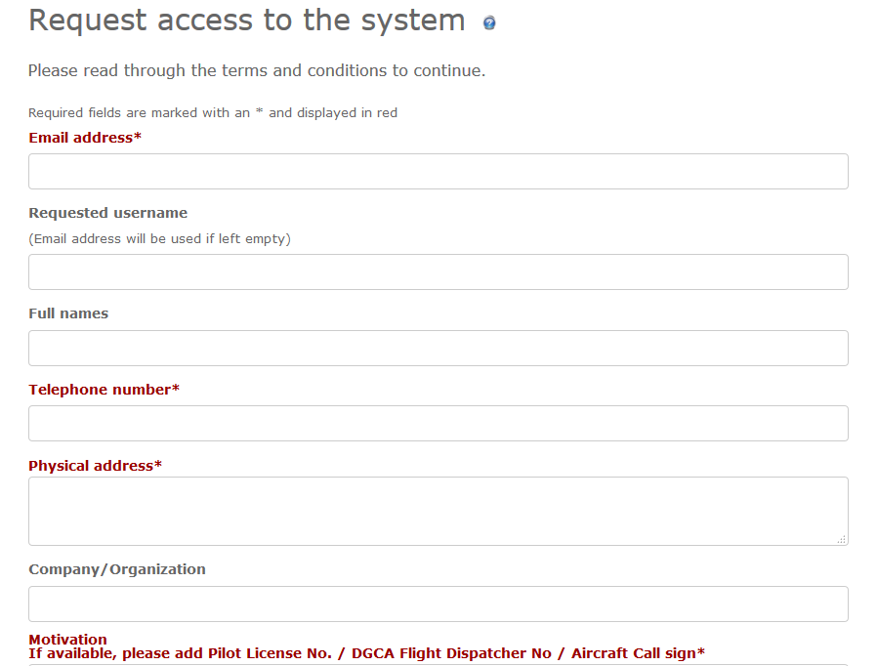
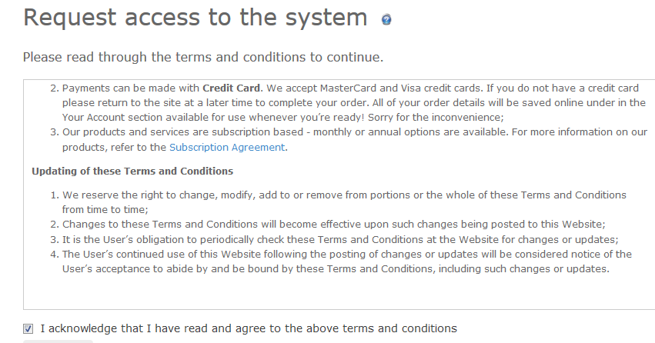
SIGN-UP TO AVIATION WEBSITE
Go to the Aviation website
Click Sign up
Follow the instructions
Provide all details (incl. Pilot License)
Start using the website products
aviation.weathersa.co.za
Important to give your Pilot License No. as this is used to grant access to the website.
Notes:
Where do they find our products?
(Explain the Sign-up process.)
Usually there is a 2-3 days turnaround time for someone to look at their application for access to the website. At the moment usage of this website is FREE OF CHARGE!!!!

Slide 11
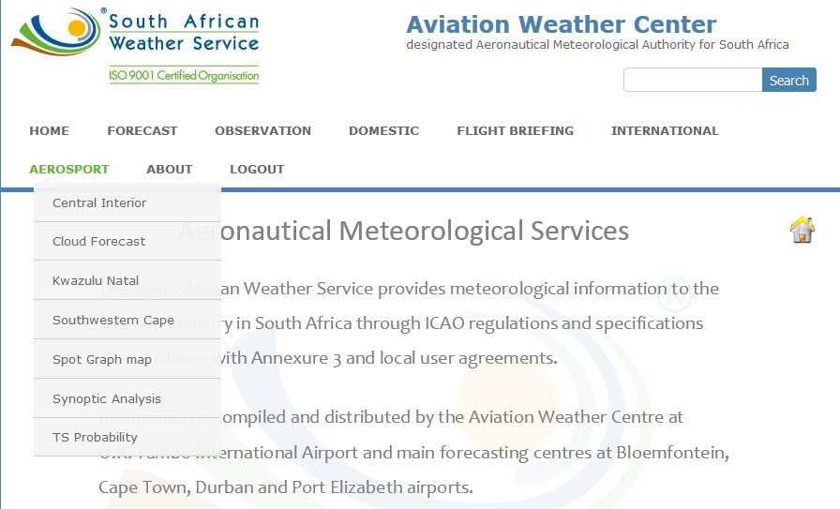
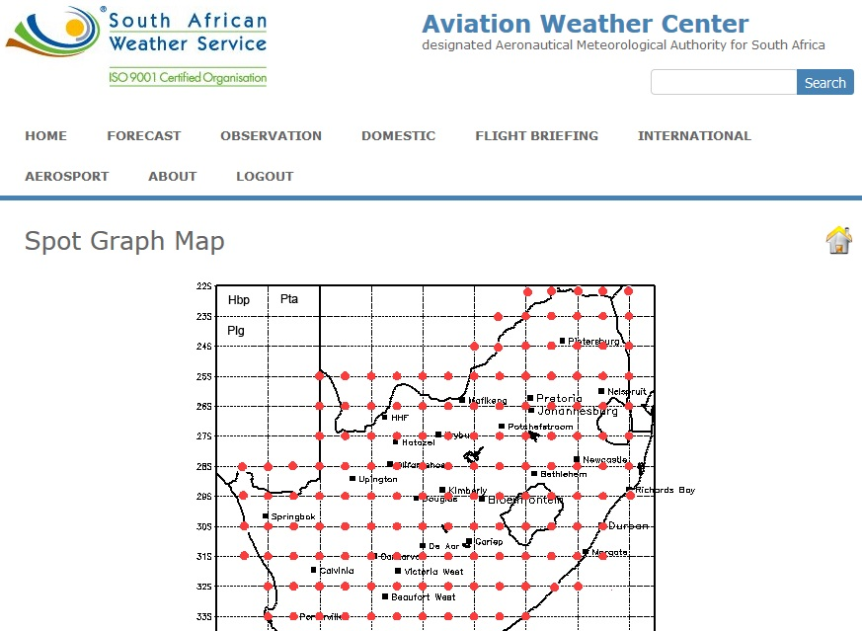
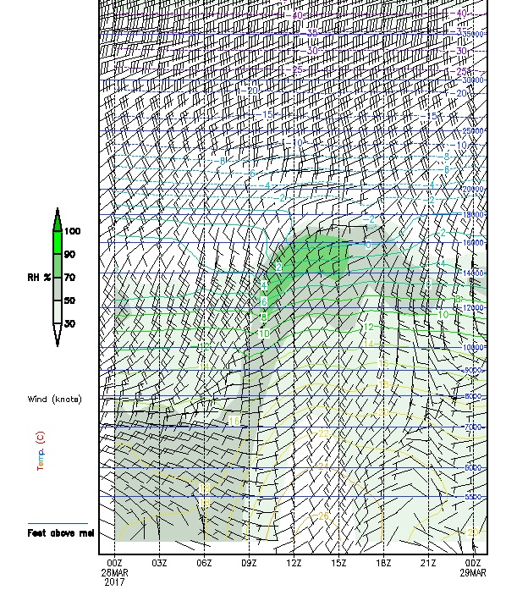
AVIATION WEBSITE - Spotgraph
Notes:
This slide shows how to get the spot graph and how to use it

Slide 12
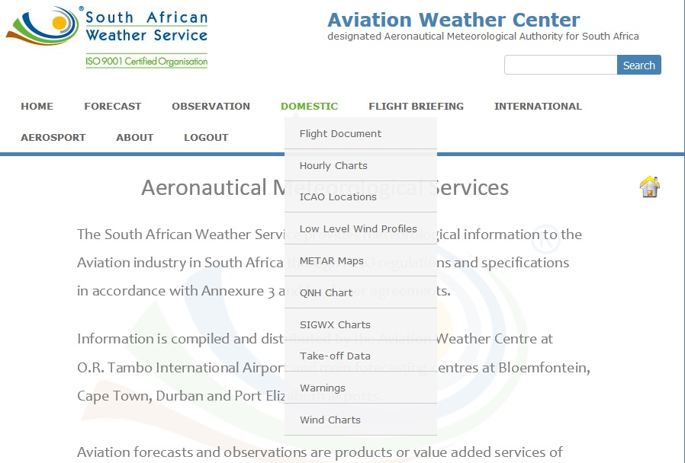
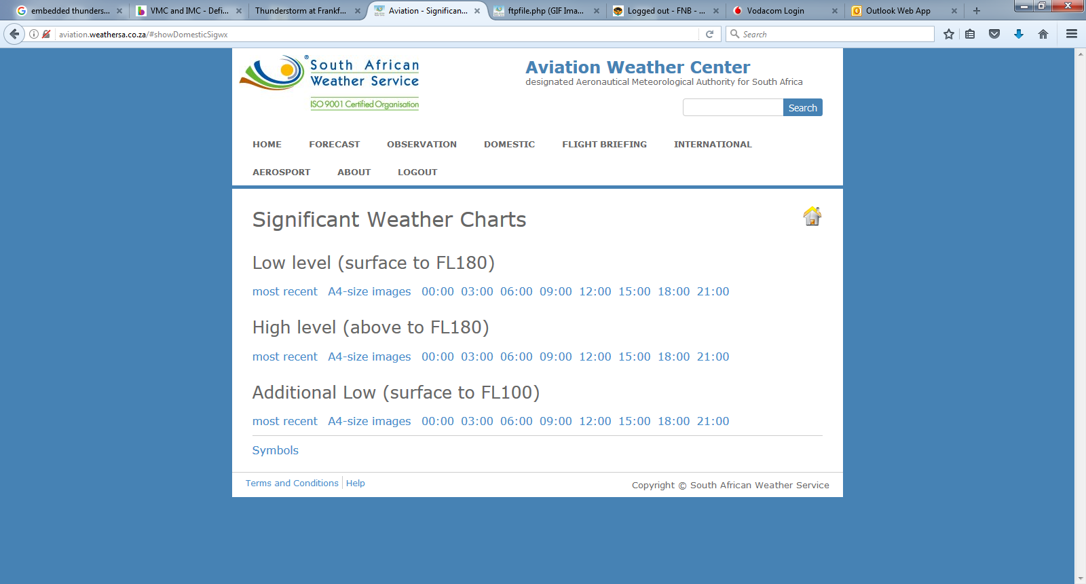
AVIATION WEBSITE - Charts
WEATHER AND CLOUDS AMSL
Notes:
This slide is to show where to get SIGWX charts from the website, most private pilots do not use this product, if they do there would not be a need to call for a forecast. These products are prepared fours before the validity time and within that four hours,they are updated ,corrected,basically QC’d

Slide 13
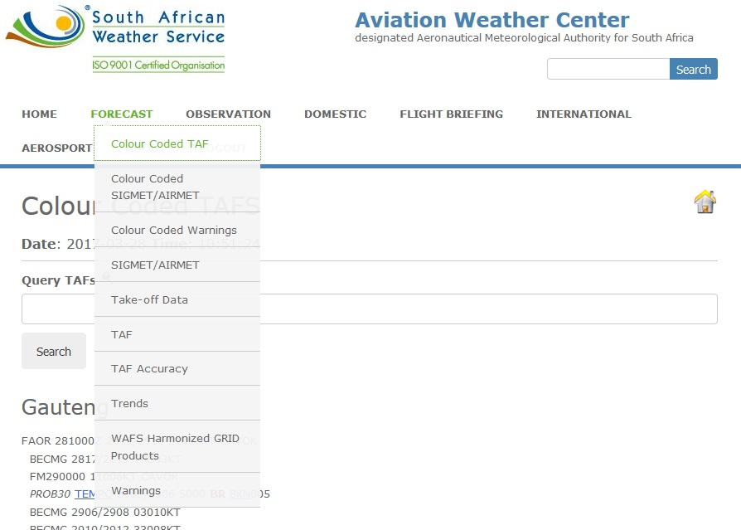
AVIATION WEBSITE – TAFs and warnings
Above Ground Level
Above Mean-sea Level
Notes:
Explain the difference between normal TAFS and coded ones. Also mention weather and cloud AGL. We speak of SIGMET/AIRMET as well on how to go about finding them.

Slide 14
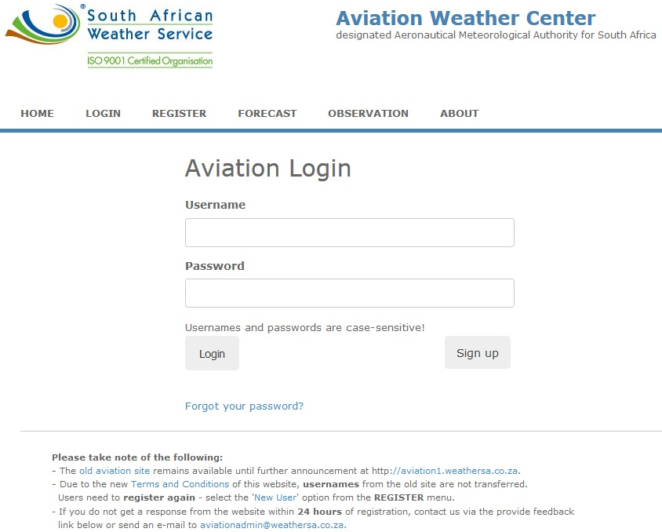
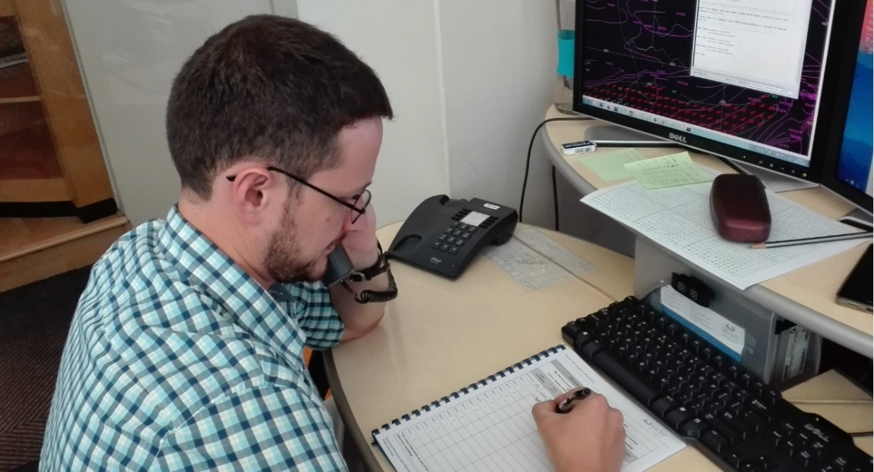
WHERE/ WHO TO ASK?
Notes:
Here at the weather service, we have two ways to provide with aviation forecast, one through a telephone briefing and another by using the website with populated products prepared by our forecaster and met tech.

Slide 15
PHONE BRIEFING
Aviation forecasts ONLY for two days
Phone call procedure
CALL SIGN
(AIRCRAFT REGISTRATION)
DEPATURE/ ARRIVAL TIME
FLIGHT LEVELS
(NOT ALTITUDES)
WHERE TO/FROM
VFR/IFR
ZS-UFP
FALA-FABL
1200Z-1400Z
FL075
Notes:
This is a procedure on how a pilot should address his flight briefing ,they tend not to give all information at one go and expect us to probe .

Slide 16
?
Do you have any questions?
?
?

