Slide 1



TO AVIATION SAFETY BY: ERIK DU RAND 2017

Slide 2

WILL
LEAD TO

Slide 3
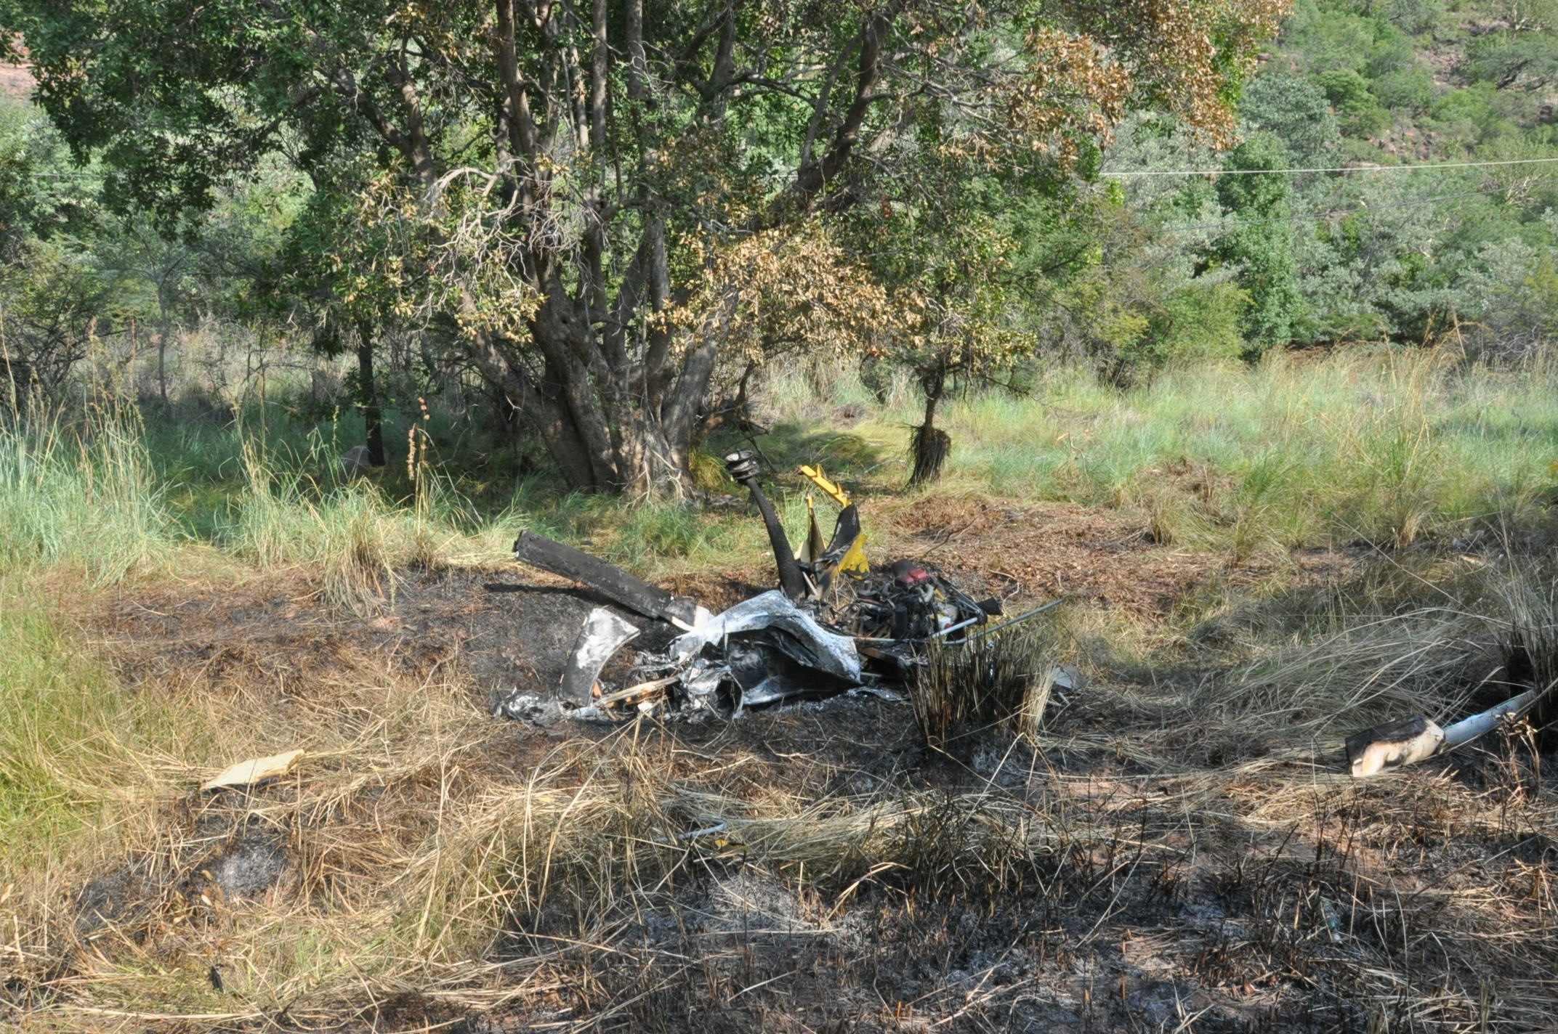
Low level fun
THIS
Collision with obstacle

Slide 4
OR WILL
LEAD TO

Slide 5
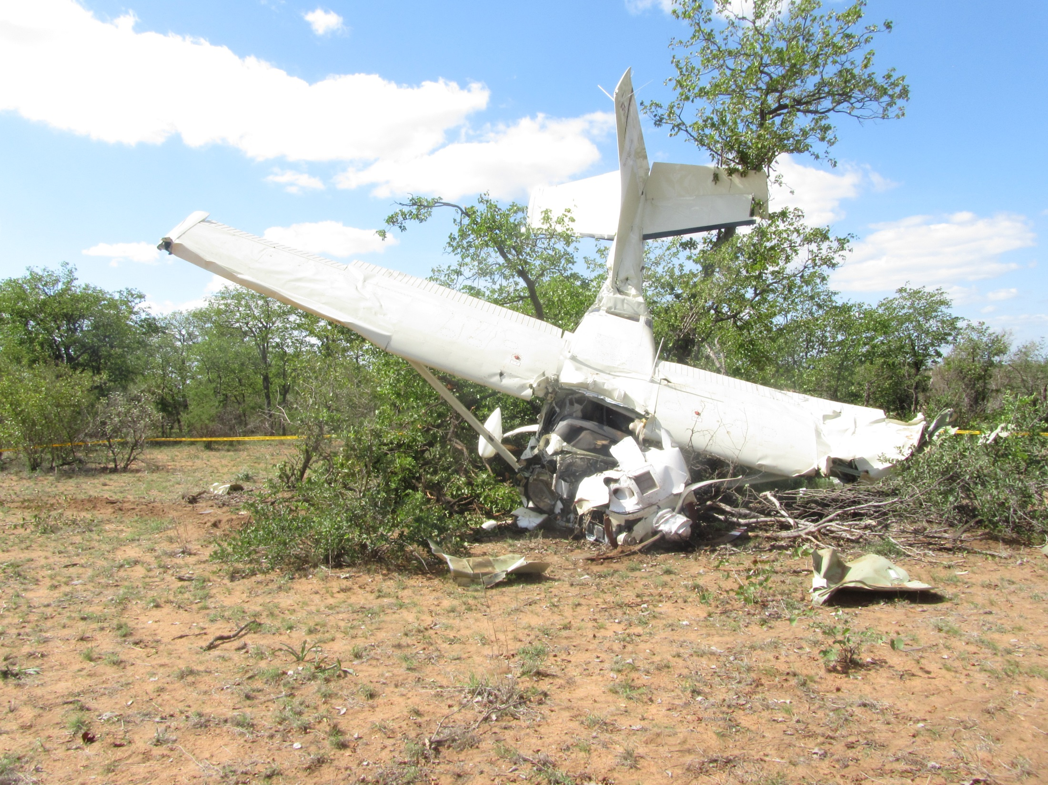
Uncontrollable situation
THIS

Slide 6
OR WILL
BE THE CAUSE OF

Slide 7
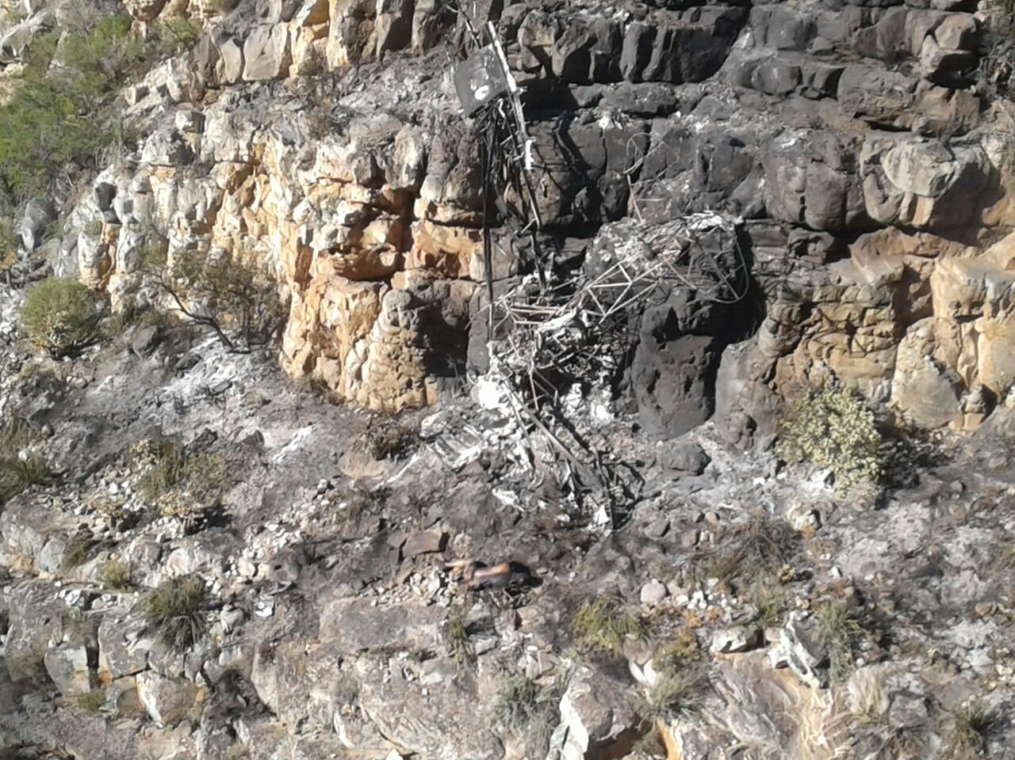
THIS

Slide 8
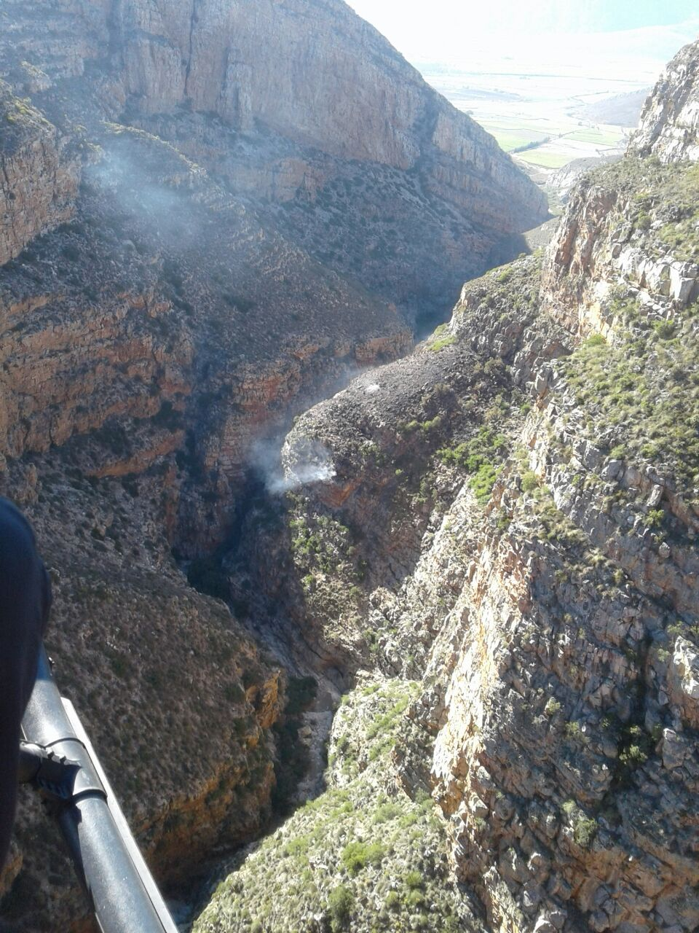
OVER HERE

Slide 9

SERIOUS INCIDENTS
In 2016 there were 19 serious incidents
48% Less Incidents than in 2015
Only 19 was reported???

Slide 10
What is a serious Incident?
Its an Incident that had a HIGH probability of an accident occurring

Slide 11
Examples of Serious Incidents
Near miss
Critical fuel situation
Decompression
Collapsed nose gear
Structural damage to control surfaces

Slide 12
INCIDENT TRENDS
BUT
IT REMAINS A CONCERN
WHY?

Slide 13


THE MAJORITY OF SERIOUS INCIDENTS REMAINS……….
PRIVATE SECTOR

Slide 14

AIRCRAFT INVOLVED IN SERIOUS INCIDENTS

Slide 15
LISENSES AND SERIOUS INCIDENTS
WHY IS THIS (ATPL)
AND THIS (CPL)
SO HIGH!!!!

Slide 16
BECAUSE WHEN AN ATPL AND CPL OPERATE COMMERCIALY
A controlled environment with a safety culture
It’s an un- controlled Safety environment
WHEN AN ATPL AND CPL OPERATE PRIVATELY

Slide 17


Accidents
In 2016 there was 79 Accidents
28% Less accidents than in 2015

Slide 18
ACCIDENT TRENDS
ALTHOUGH THERE IS A DECREASE
ITS NOT GOOD ENOUGH
WHY?

Slide 19
THE MAJORITY OF ACCIDENTS OCCURS IN……….
PRIVATE SECTOR

Slide 20
LISENSES AND ACCIDENTS
PPL
AND CPL

Slide 21
WHY IS THE MAJORITY OF ACCIDENTS IN THE PRIVATE SECTOR ?
WHY!!!!!!
Un-controlled safety environment in the Private sector
Misconception of aviation safety
Lack of safety culture in the private sector

Slide 22
WHAT'S
TO SAFETY

Slide 23
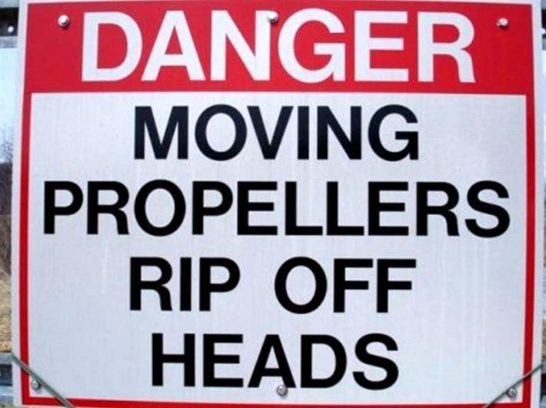


Misconception of aviation safety
OR IS YOUR APPROACH

Slide 24
ATTITUDE
A Positive attitude towards safety. Flight safety should be the first priority
WILLINGNESS
Willing to report , share and discuss previous experiences
A POSITIVE SAFETY CULTURE
Proactive approach to THREATS
Identify unsafe situations
LEARNING CULTURE
Improving your knowledge from safety information and the will to implement

Slide 25
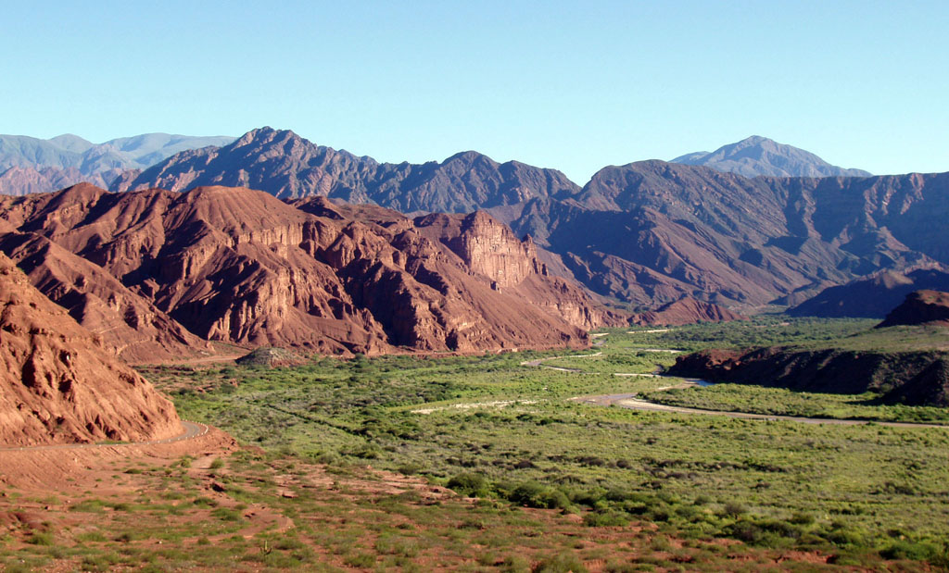
An OBJECT or an ACT that are likely to cause damage, danger or death.
IDENTIFYING POTENTIAL THREATS
WHAT IS A THREAT?
THE POTENTIAL THREAT/ HAZARD

Slide 26
THE RISK
&
RESULT

Slide 27
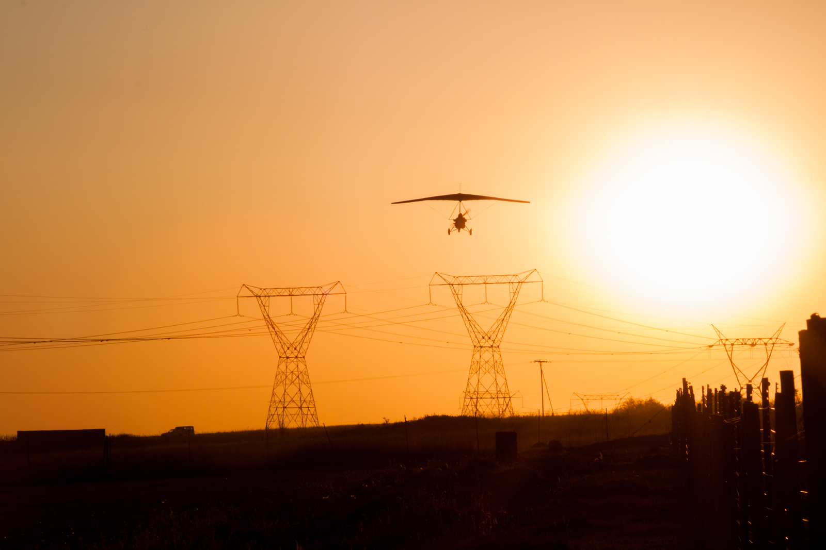
THE POTENTIAL THREAT/HAZARD
THE RISK

Slide 28
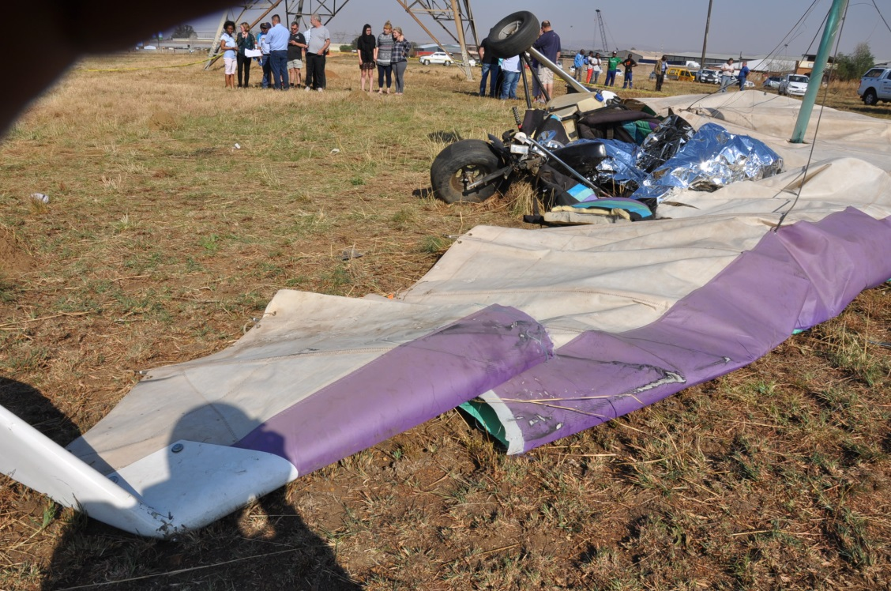
THE RESULT

Slide 29
DETERMINE IF THE RESULT OF THE RISK IS ACCEPTABLE
LOOK FOR WAYS TO REDUCE RISK
YOUR GOAL SHOULD BE TO
ESTABLISHING A SAFETY GOAL
ANALYSE AND ASSESS THE RISK INVOLVED
IDENTIFY SAFETY ISSUES AND THREATS

Slide 30
DON’T IGNORE THE THREATS……
DEAL WITH THEM!
TO TRANSFORM RISK IN EVERY AVIATION ACTIVITY TO A LOWER AND MORE ACCEPTABLE LEVEL

Slide 31
